Slide 1



AWAKENING THE FORCE WITHIN: A LEADERSHIP WORKSHOP FOR PTA PRESIDENTS
Gerrod Tyler - FREE STATE PTA
JULY 21.2024

Slide 2


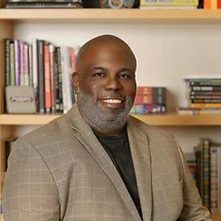

Gerrod Tyler
  Current President of Free State PTA
  Previously served as President Elect and Vice President for Leadership
  Served as a local unit President for four years at Maya Angelou French Immersion PTSA

Slide 3



Objectives
01
Understand the Role of President
02
Understand the Intangibles
03
Conflict Resolution
04
Effective Planning

Slide 4

Congratulations
You’re President
  Do not think you can go it alone and simply find out the answers on the internet.
  Realize you don’t know everything but also realize that you probably know more than you think.
  You are running a non-profit and all non-profits have specific structures and guidelines. The training offered by PTA is aligned with these guidelines.

Slide 5
Things to Know
Know Your Bylaws
Know Your Role
Know Your Plan
  Preside over Meetings
  Ex-officio on all committees
(except Nominating Committee)
  Represents the PTA
All actions must be approved by the general membership or the executive board. Your executive committee can and should meet to do planning and have discussion but they are not charged with approval action.
Don’t assume you can just operate the way it’s always been done. Make sure the unit has been following their bylaws. If not make sure to following them and if they need to be updated form a committee.
  Strategic Plan/Org Goals
  Board Training Plan
  Communications Plan
  Volunteer Plan
  DEI Plan
  Standards of Affiliation

Slide 6


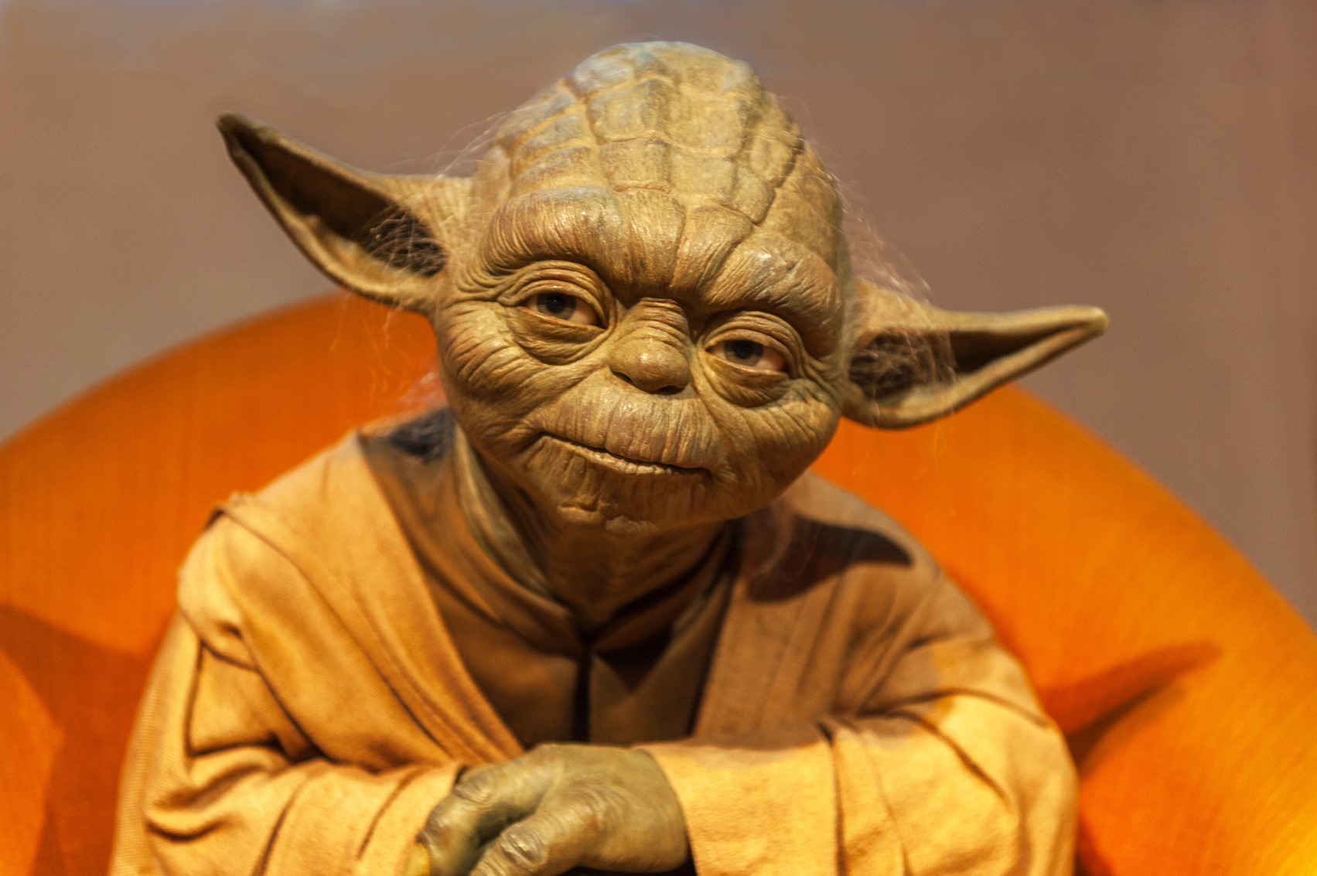
A President is a
Leader and not a Boss

Slide 7


Quote
“There is a difference between being a leader and being a boss. Both are based on authority. A boss demands blind obedience; a leader earns his authority through understanding and trust.”
— Klaus Balkenhol

Slide 8
Quote
It is better to lead from behind and to others in front, especially when you celebrate victory when nice things occur. You take the front line when there is dange. Then people will appreciate your Leadership
~ Nelson Mandela

Slide 9
The Intangibles - Learn Your Board
01
02
03
PERSONALITIES
COMMUNICATION STYLE
MOTIVATIONS
  Foster a Cohesive Team Dynamic
  Recognize Strengths, Weaknesses and Working Styles
  Mitigate potential conflicts
  Ensures smooth and Effective Communication
  Enhances engagement
  Builds Stronger Relationships
  Ensures everyone’s ideas and concerns are addressed promptly and appropriately.
  Allows the President to align individual passions and goals with the PTA's objectives
  Fosters a sense of purpose and commitment.
  Helps the President to delegate tasks in a way that maximizes each member's potential and satisfaction, creating a more dynamic and motivated board

Slide 10
Quote
“The greatest people are self-managing – they don’t need to be managed. Once they know what to do, they’ll go figure out how to do it. What they need is a common vision. And that’s what leadership is: [h]aving a vision; being able to articulate that so the people around you can understand it; and getting a consensus on a common vision.”
~ Steve Jobs

Slide 11




Understand Your Data
Understanding key metrics such as membership numbers, fundraising totals, event participation rates, and volunteer engagement levels provides a clear picture of the organization's health and impact.
Allows the President to identify strengths and areas for improvement, set realistic goals, and measure progress over time.
Facilitates transparent communication with members, stakeholders, and the school community, fostering trust and support

Slide 12

GET DIGITAL - WORK SMART
PTA Presidents should use digital tools in their local PTA to enhance efficiency, communication, and engagement. Digital tools streamline administrative tasks such as managing membership databases, tracking finances, and organizing events, saving time and reducing errors. Additionally, they provide valuable insights through data analytics, helping the President make informed decisions and tailor initiatives to meet the community's needs. Embracing digital tools modernizes the PTA, making it more accessible and responsive to the needs of the school community.
  Communication
  Meeting/Events
They also facilitate better communication through platforms like email newsletters, social media, and dedicated apps, keeping members informed and connected.
Digital tools can increase participation by making it easier for parents to sign up for events, volunteer opportunities, and contribute to fundraising efforts.

Slide 13
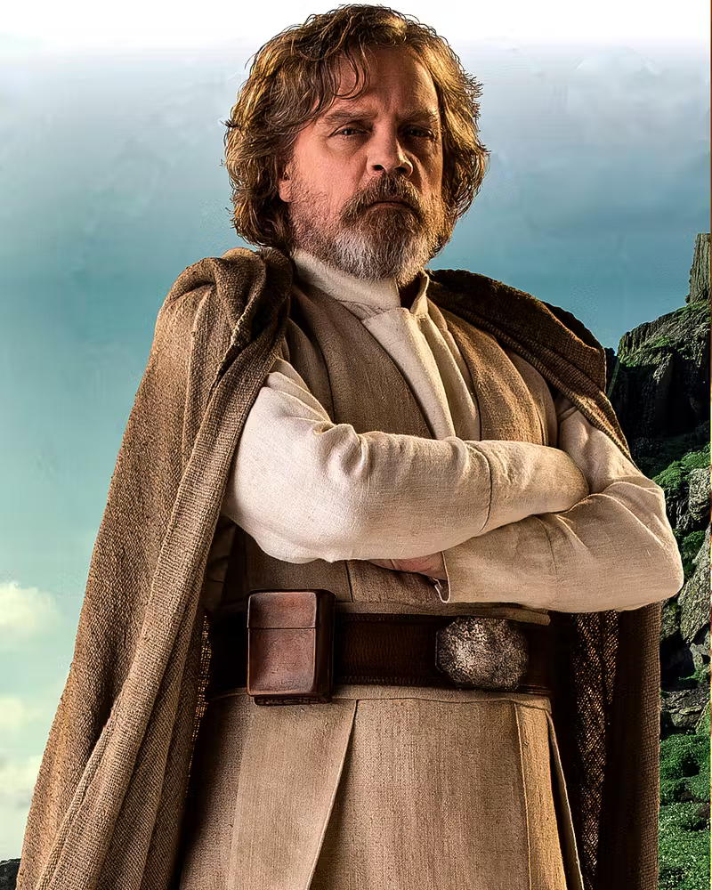
CONFLICT RESOLUTION
Presidents should handle conflict resolution in their local PTA by adopting a proactive and empathetic approach.
  Create an environment of open communication, where members feel comfortable expressing their concerns
  Address them promptly, listening to all parties involved to understand their perspectives fully.
  Remain neutral and fair, focusing on the issues rather than personal differences.

Slide 14
Quote
If you don’t like something change it. If you can’t change it, change your attitude.
~ Maya Angelou

Slide 15
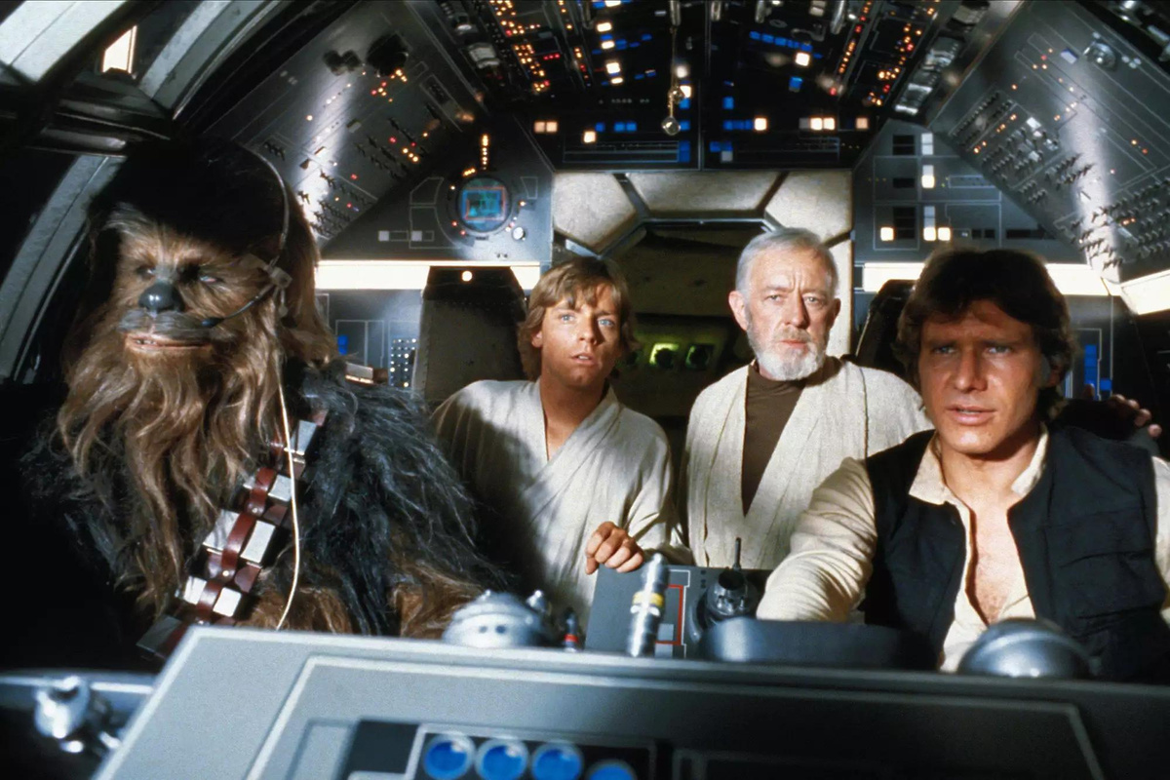
Effective Planning
01
Organize Events
Effective planning is crucial for PTA Presidents as it ensures the smooth operation and success of the organization. With a well-structured plan, Presidents along with the Board of Directors can set clear goals, allocate resources efficiently, and anticipate potential challenges.
Planning enables the President to organize events, fundraisers, and meetings in a timely and orderly manner, ensuring that all activities align with the PTA's objectives and the school’s needs.
02
Coordinate Logistics
It also helps in coordinating volunteers, managing budgets, and tracking progress, thereby enhancing transparency and accountability.
03
Drive Meaningful Outcomes
By prioritizing thorough and strategic planning, PTA Presidents can lead with confidence and drive meaningful outcomes for the school community.

Slide 16




CONTACT
www.fspta.org
info@fspta.org
@FSPTA Leaders
5730 Cottonworth Ave. Box 20924
Baltimore, MD 21209

Slide 17

THANK YOU!
MAY THE F.O.R.C.E. BE WITH YOU

