Slide 1
Advancing Diversity, Equity and Inclusion in Your PTA
Presented by Yvonne Johnson
National PTA President

Slide 2

Our Shared Mission:
To make every child’s potential a reality by engaging and empowering families and communities to advocate for all children.

Slide 3


Why is DEI Important in your PTA?
This Photo by Unknown Author is licensed under CC BY
Notes:
Tell me why you think diversity, equity and inclusiveness is important
Building relationships and establishing trust is your first step in inviting more diverse members into your PTA and being more inclusive of diverse people.
Make this a best practice at your PTA meetings – live or virtual. Greet members at the door, or as they login. Introduce the Principal and PTA leadership at the beginning of the meeting and before they speak. Make people feel like they are part of the group, that they are welcome in the space with introductions.
Why does DEI matter?
We are an organization founded from diverse leadership, ideas and lived experiences, yet always shared a common goal of supporting children and ensuring their potentials turned into their realities
To properly embody our mission, we must ensure that families from all backgrounds and walks of life, have a seat at the table and can advocate for their child and their needs

Slide 4
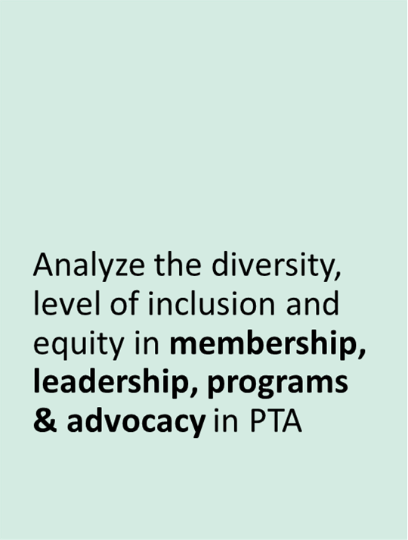
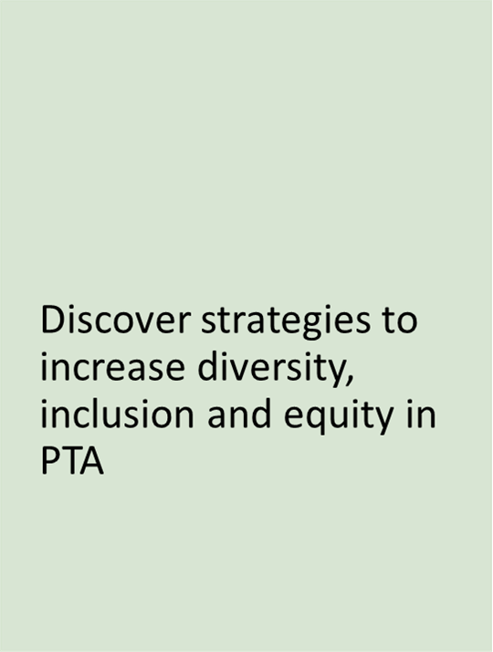

Objectives:
1
3
Define concepts of diversity, inclusion, and equity and how it can apply to your local PTA
Notes:
When PTAs acknowledge and respect the diverse cultures and perspectives in their school communities and actively work to be inclusive of all families, we are positioned to develop meaningful priorities, practices and programs that uplift ever child towards their academic and personal development.
In this workshop, we will define diversity, inclusion, and equity and discuss these concepts in relation to PTA membership, leadership, programs, and advocacy. Attendees will analyze practices in their own PTA unit (local, council or state), share ideas, and outline strategies to implement.
What we really want to do is answer the question: We scheduled the PTA meeting – why don’t they come?

Slide 5



What does it mean?

Slide 6
Equity vs Equality
Equality is :
the uniform distribution of a good or service to everyone regardless of their individual circumstances.
Everyone is treated the same way regardless of age, race, gender, sexual identity, religion, and status
Social equality is a state of affairs in which all individuals within society have equal rights, liberties, and status, possibly including civil rights, freedom of expression, autonomy, and equal access to certain public goods and social services.
Equity is:
the fair distribution of goods and services based on individual need. Those who start with less are given more of the commodity, while those who have more receive less of it.
Equity is recognizing and addressing bias and privilege.
Understanding specific individual and community needs
Providing resources to those with greater needs.
Notes:
In other words, each person receives the same amount of whatever commodity is being distributed, regardless of their individual circumstances.
On the surface, equality is appealing. If everybody is given the same amount of a good, nobody receives less of that good, which is fair. However, this does not eliminate any inequality that exists prior to the distribution of the good.
Equity aims to shrink that initial gap between those with more and those with less. The equitable distribution of crates to the boys trying to see over the fence results in all of them being at the same height after the disbursement of the crates. The shortest boy with two crates is now the same height as the medium-sized boy with one crate and the tallest boy with no crate.
Equity and equality are both desirable for society, but which is preferable depends on what good or resource is up for grabs

Slide 7
Equitable Membership
WHAT IT LOOKS LIKE:
Asking EVERY parent/guardian to join the PTA.
Partnering with community organizations to reach out to potential members.
Sharing messages that convey that every parent/guardian belongs in PTA.
Membership reflects the diversity of the communities served.
Notes:
What families are not represented in your PTA – that’s your target list. How are you going to reach them?
A general approach looks like:
- Have little to no engagement with parents/guardians/community members who do not actively seek out organization
- Assuming everyone knows what PTA is about
- Not collecting or analyzing data by demographic group

Slide 8
Create Effective Messaging
Why does PTA exists
What has your PTA achieved
How do families that are engaged with PTA benefit them, their children, and the school community.
How to address issues that matter most to the families and communities whom you seek to engage.
What does your PTA expect from its’ members
Notes:
Why PTA exists: what are the goals? What do you stand for?
What your PTA expects from members—dues, volunteering, advocacy, meetings, etc.

Slide 9
Equitable Leadership
What It May Look Like:
Review bylaws and standing rules for leadership requirements that may limit diversity in leadership.
A Diversity Committee helps every committee use a “DEI lens” for their workplans.
Measure your progress on DEI efforts – both in headcounts and in impacts.
Be intentional
Notes:
General approach:
Rotate the same PTA leaders, each year, as they move from school to school
Nominating Committee asks people they know to run for office
Might plan a couple of activities focused on diversity
Instead:
We create leaders by encouraging active membership.
Realize – parents may have a lot of knowledge & skills to contribute, even if you’ve never seen them in a PTA meeting. You won’t know that the dad is an accountant, the mother does web-design, the grandmother is an ASL translator – until you ask.

Slide 10
Equitable Programs
Different programs from year to year—parent/guardian participation, ELL supports, activities to take home, & feedback opportunities
Different program topics:
  College application prep
  Summer employment options
Notes:
With a general approach
- Program Committee hosts the same program(s) annually.
Instead:
Invite a new, diverse group of parents to be on the Program Committee
Have feedback loops to seek input from underrepresented groups/respond to community feedback
Programs keep pace of changing needs for parents, particularly those of underserved populations
Programs are accessible and relevant for families

Slide 11
Equitable Advocacy
Advocating for content that covers indigenous experiences
Advocating for inclusive curriculum
Advocating for all students to receive free breakfast and lunch in school regardless of income
Discussing disproportionate discipline with school leaders
Advocating for more teachers who are reflective of the school population.
Coaching a parent/guardian(s) on how to advocate for his/her/their child to receive necessary education services.
Notes:
Generally, this looks like:
Fear that lifting issues of difference and diversity will create conflict.
Understanding disparities in children’s educational success, health and well-being exist, but choose not to incorporate in advocacy plan.
Do not have members from underrepresented population at the table to establish advocacy agenda.

Slide 12

Collaboration Must Be Inclusive.
To foster an association where everyone feels they belong, we must:
Collaborate and partner with the broadest possible set of volunteers, staff, educators, schools & communities.
Be intentional
Set up a level playing field for all to engage in our work.
Ask people to get involved
Practice what you preach

Slide 13

Diversity is Our Strength
What is PTA’s Strength?
It is one of our values
We have 127 years of advocating for all children and families
Our collective backgrounds, rich history, perspectives and ideas allow us to reflect on the past, present, and future.
Our Public Policy Platform focuses on safe, naturing and inclusive practices
Our differences bring us together as one PTA!
Notes:
We represent parents, caregivers, educators and communities of all children, which enables us to best achieve PTA’s mission to make every child’s potential a reality.
Social equality is a state of affairs in which all individuals within society have equal rights, liberties, and status, possibly including civil rights, freedom of expression, autonomy, and equal access to certain public goods and social services.

Slide 14
Diversity, Equity, & Inclusion Stages
Beginning: PTAs are “color/identity-blind” by design or default.
Emerging: PTAs are focused on adding diversity.
Intermediate: PTAs are focused on culture & an environment where everyone is comfortable contributing.
Advanced: PTA are focused on systems to improve equity.
Notes:
Tell me what stage your PTA has achieved:
Beginning: PTAs do not lift up issues of diversity, inclusion, and equity in any regular or routine way.
Emerging: the focus is on recruiting and building membership and leadership with individuals from different backgrounds and experiences.
Intermediate: the focus is on really creating that environment so that everyone is comfortable sharing their experiences for the good of the association.
Advanced: the primary goal is integration of an equity lens into all aspects of the association’s work.

Slide 15
Things You Can Do
Know your school/council/district/state and PTA data
Be intentional
Identify barriers in your community
  Cultural
  Socio-economic
  Programs, policies, practices
  Relevancy of advocacy issues
Notes:
Know your data:
Understand your school/council/district/state demographic makeup:
absentee rate
enrollment
students receiving special services
discipline (suspensions & expulsions)
graduation rate, etc.
Cultural: expectations of parents’/guardians’ role, feeling welcome, language
Socio-economic: costs, availability, other priorities
Programs, policies, practices: meeting format, activities and meeting topics
Relevancy of advocacy issues: academic success of students, relevant to parents’ concerns & priorities, accessible advocacy activities

Slide 16
How will you practice DEI in your PTA after today?
Notes:
Share what you will do or a new behavior to diversify your PTA

Slide 17

Questions?

