Slide 1


Basic Parliamentary Procedure
Kelly L. Lucas, RP
kellylucas97@yahoo.com
301-642-8489
Notes:
Good Afternoon, thank you for having me today and I appreciate the opportunity to share basic parliamentary procedure and have fun with it.
Just a little about me and how I got here. I saw this workshop called Parliamentary Procedure at a conference and thought it sounded interesting. Once inside, I got really excited because they talked about being organized and doing things in order. I took the exam for membership – not really knowing what that meant – and passed. That was my beginning and then like most of us newbies, I starting really listening at chapter meetings saying to myself – that’s not right! So I have made it my mission to teach others how to properly conduct meetings and to - fight fair! I am currently the president of Anne Arundel County unit of Parliamentarians, the financial secretary for Howard County, the Treasurer for Maryland State Association of Parliamentarians, and education chairman for the DC Association of Parliamentarians. I received my credential of RP in November of 2022 and am in continuous study to learn as much as I can everyday. So lets get started.
(IF THEY READ THE BIO, START WITH THE VIDEO)

Slide 2
Basic Parliamentary Procedure
Meeting from Hell! Running A Meeting or Drowning in Chaos? https://www.youtube.com/watch?v=xQW1fEwYZVA
Notes:
To get us in the mood, so to speak, lets watch a little clip I have. (HAVE TECH PLAY) We’ll come back to that little chaos at the end of this presentation so I hope you paid attention while laughing. Next slide

Slide 3
House Rules
You must participate
YOU MUST PARTICIPATE
Ask questions at anytime BUT you must participate
Notes:
I love to teach but I don’t like talking to myself so here are the rules. (Read them) I am not going to read each slide to you but we’re going to have a conversation. Everybody ok with that?

Slide 4
GOALS
WHY – do we have rules
WHO – can use those rules and who decides
WHEN – to use proper procedure
HOW – to use the rules for an effective and efficient meeting
Notes:
We’re going to touch on a few basics today. How many of you have a fundamental awareness of Roberts Rules, meaning you know that it exists and that it is used and you think sometimes you are following (raise your hand). How many of you are Novice, meaning you have a limited experience in using Roberts (raise), How many of you are at the intermediate level, meaning you understand and use the practical application of Roberts. How many of you consider yourselves advanced, meaning you understand, are able to apply and possibly teach Roberts? No matter where you are in your understanding, I have found that organizations conduct themselves in a manner that fits them. Roberts Rules is a guide, used to help organizations, not hinder them. Today we’ll talk about the fundamental basics on how to run and participate in a meeting. At the end of this presentation you should know why we have rules, who can use them and who decides that, when to use certain motions, and how to use the rules to work for you not against you.

Slide 5

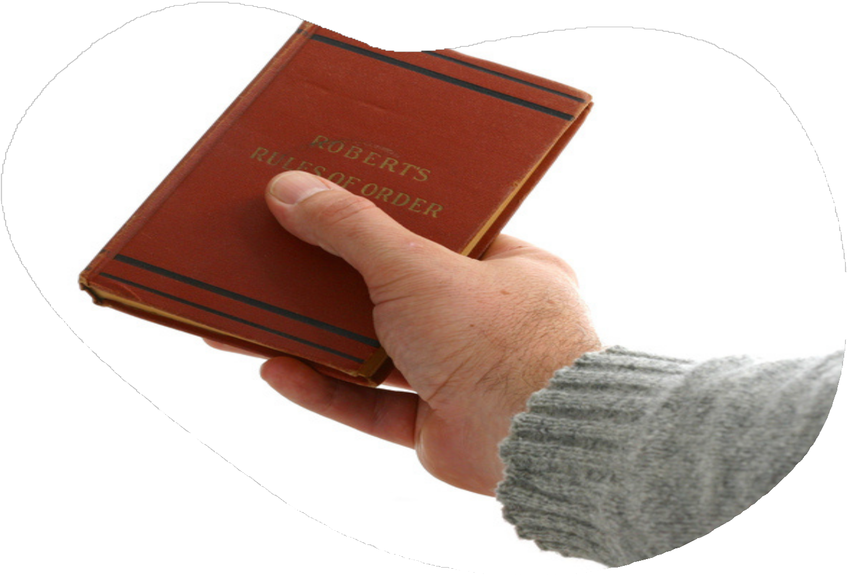
PARLIAMENTARY LAW
What is this and who is Robert?
Notes:
So what is parliamentary law and who the heck is Robert? Parliamentary law are the common rules and customs developed that govern an organization. Henry Martyn Robert was a brigadier general who was asked to preside over a meeting in 1863 and realized he didn’t know how and there was not one guide available to assist. So he set out on a mission to produce one. The first one was published in 1876. You can read the history in the front of the book. We are now on the 12th edition and it is amended every 10 years.

Slide 6
PRINCIPLES OF PARLIAMENTARY LAW
Only those present can vote
Changing an action requires a higher vote than taking the same
Organizations must follow their own rules
Absentee Rights – previous notice
Majority Rules
Minority Rights – 2/3 vote
One question at a time
One person, one vote
Notes:
Parliamentary law is based on certain principles that are listed here. Nine times out of ten, any action requires a majority vote which indicates that more than half of the organization wants something done. When the thing being asked infringes on the rights of the members then it requires a higher vote which is 2/3. You can only process one question at a time otherwise confusion sets in. If you hold the positions of secretary and vice president, you have one vote, not a vote per position. You must be present for your vote to count. You must follow your own rules, or bylaws and in order to be fair to those who may not attend a meeting, previous notice must be given of certain motions to be voted on. This ensures that those who were not in attendance were duly notified that an action would take place and they chose not to be part of that action. Next slide

Slide 7
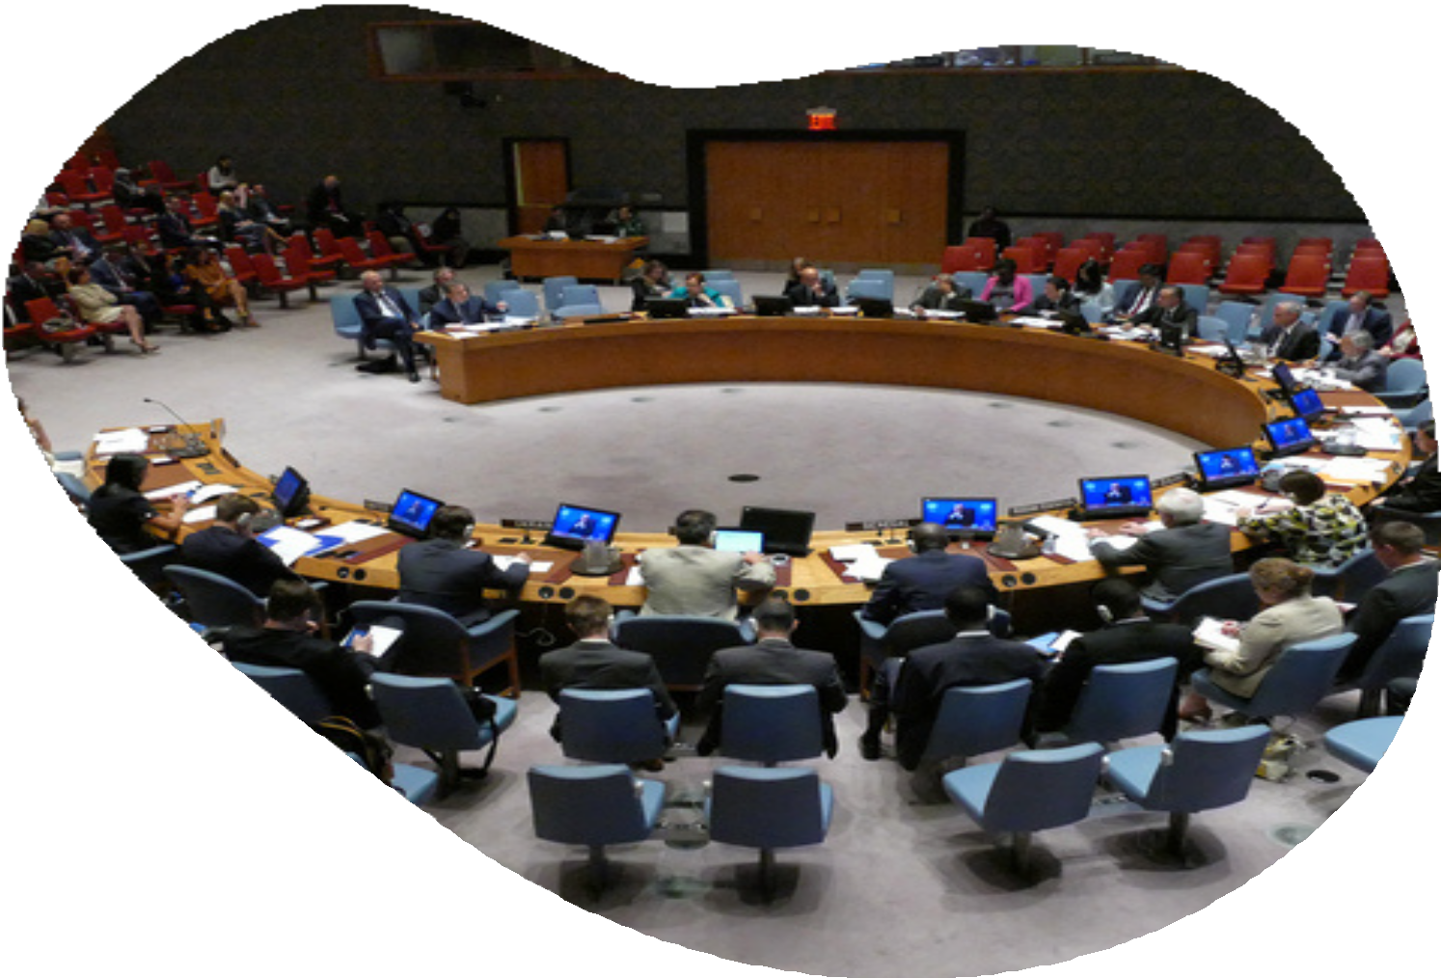

Member Rights
To attend meetings
To make motions
To speak in debate
To vote
Notes:
Did you know that you are the most important person in the meeting? Who can tell me why? Did you also know that the officers only have the power you give them? Part of that is through your bylaws. We’ll talk a little more about the bylaws later.

Slide 8
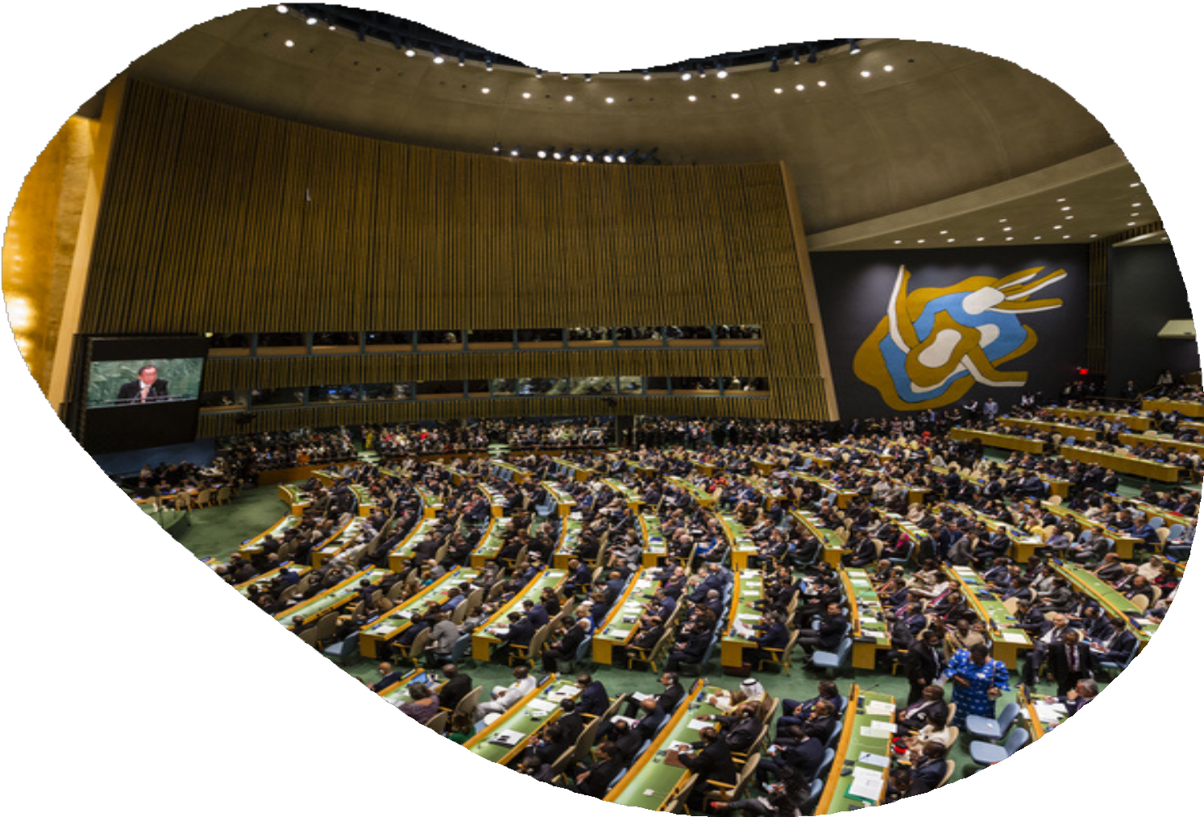
Rules of Assembly or Organization
Corporate Charter (also known as Articles of Incorporation
Constitution/Bylaws
Special Rules of Order
Parliamentary Authority
Standing Rules
Custom
Notes:
The bylaws are one of your governing documents and is actually the most important. Who can tell me why? Listed here is the hierarchy. Most organizations have articles of incorporation which establishes you in the jurisdiction where you are located. Then there is the constitution and bylaws. Now it is not necessary to have a constitution AND bylaws but some organizations have two separate documents and others have one encompassing all those rules. Again your bylaws are the most important because this is where you look first when you are determining what your organization is supposed to do. Then you have your special rules of order which are deviations from RONR such as debate limits. RONR states that each member can speak twice for 10 minutes on each question per day. If you think about it, that’s a long time and can take your meeting from two hours to five! So what I advise organizations is to have a special rule of order that states that each member may speak twice for two minutes. Then we have RONR or some other authority like Demeter. Then we have our standing rules which are administrative in nature. This is where you would have things like rules for a virtual meeting. Lastly we have custom – who can tell me one of your customs. These are things that we do because that’s what we’ve always done. Once a custom is challenged, the rule must be followed and the custom falls to the ground.

Slide 9
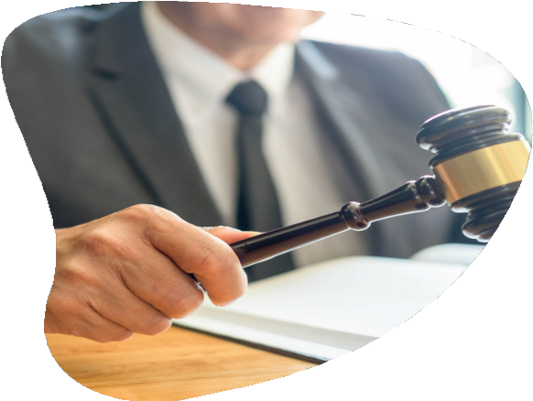
Presiding Officer
Maintains position of impartiality
Speaks in the third person
Prepares agenda
Keeps meeting on track
Sets the tone for decorum
Does not participate in debate
Basic knowledge of parliamentary procedure
May assist in the preparation of a motion
Does not interrupt speaker
Enforces the rules
Rules that……
Notes:
Let’s talk about the Presiding officer. Who is this normally? (The president) Here are the duties of the presiding officer. The most important job he has is to be impartial and to keep the meeting on track. How many of you have seen presiding officers who think the meeting is theirs? Remember that meeting belongs to you and he has no more power than what you give him.

Slide 10
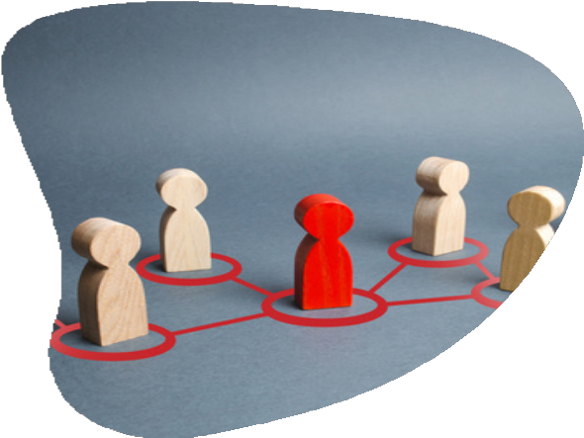
Members
Refer to the presiding officer as “Chair”, other officers by their title
Must be recognized before speaking
Comments/questions directed to the chair
Attack the comment, not the member or the motive
Refrain from disturbing the assembly
Confine remarks to the issue at hand
Notes:
As a member, you have certain responsibilities as you see here. Which one of these do you think is the most important. Why? There is no wrong answer. They are all important.

Slide 11
Order of Business
Opening Ceremonies
Roll Call
Approval of Agenda
Call to Order
Quorum?
Notes:
Now that we know the players in the meeting – so to speak – lets talk about the meeting and how all that comes together. You see here the Order of Business, sometimes it is called an agenda or a program. They are used interchangeably. Why do you think we have an order of business? So first we open the meeting with a prayer, pledge, whatever your organization is used to. Roll Call is one of those optional headings. If you have adopted RONR as your parliamentary authority and are using the standard order of business as listed in 41:5, you do not have to adopt the agenda at every meeting. It is customary to adopt the agenda at each meeting because it changes for most organizations. How many of you are used to seeing call to order at the top of the agenda? According to RONR 3:17 (fn3) it is not proper to list call to order as the first item of business in an agenda. Does anyone want to guess why? What does quorum mean? The least number of people required to attend the meeting in order for business to be transacted. Protecting the rights of the majority. Where is that number located – the quorum? That number should be in your bylaws.

Slide 12
Order of Business
M.R.S.S.U.N.
Reading and Approval of Minutes
Reports of Officers, Boards, and Standing Committees
Special Committee Reports
Special Orders
Unfinished Business and General Orders
New Business
Announcements/Program
Adjourn
Notes:
Here is a standard order of business which is commonly used. You see the mnemonic here MRSSUN. Anyone unfamiliar with this order of business or have any questions? We’re gonna have a little exercise next. Make sure you have something to write on. (MAKE COPIES OF THIS TO PASS OUT)

Slide 13
Scenario
The monthly meeting of the Rug Makers is on Saturday, July 27, 2024. You have been tasked to prepare the agenda.
The president, treasurer, and vice president will have a report
The membership and investment committees will have a report. The Charter Day (ad hoc) committee will have a report
There will be an education session at this meeting
Notes:
Here is your scenario. You must prepare an agenda and you have five minutes to do it using what we just talked about. Any questions? Your time starts now.

Slide 14
Minutes
Are there any corrections to the minutes?
If there are no (further) corrections, the minutes are approved as presented (corrected)
Minutes reflect what was DONE, not what was SAID
“Submitted by” Secretary
Notes:
Now that we have the agenda and we’ve adopted it, we are going to approve the minutes. PLEASE remember the minutes are a record of what was done, not what was said. How many pages are your minutes? If you took out all the stuff that everyone said, how many pages would it be? What you see here is how the presiding officer processes the approval of the minutes. The next item of business is the approval of the June 2, 2024 minutes. The minutes were in the meeting packet and are before you. (Read above) If there are corrections, they can be handled by unanimous consent. Who can tell me what unanimous consent is?

Slide 15
Making a Motion
Main Motion
A formal proposal that the assembly take certain action
Main motion - anything and anyone EXCEPT presiding officer and parliamentarian
Secondary Motion
Motions that bring a question again before the assembly
Notes:
Ok now we are in the thick of things at the meeting and someone wants the organization to do something. That’s called making a motion. That is how business takes place. No one person decides. Someone makes the “suggestion”, it is discussed and then everyone votes. The motion can be on anything and anyone can make it. Why can’t the presiding officer or the parliamentarian make motions? They must remain impartial which also means they do not vote except when ballot voting. When can the presiding officer vote? To make or break a tie. Why would they want to do that?

Slide 16
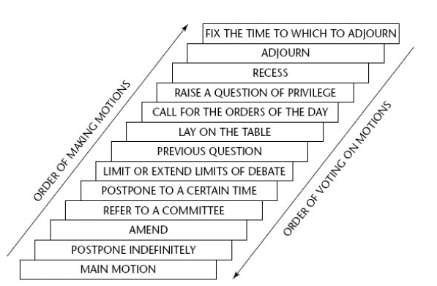
Order of Precedence
Notes:
As stated before, a motion can be concerned with anything within the object of the organization. There are 13 ranking motions which are listed here in the order of precedence. (Yes that is how it is pronounced). You can also find this in your tinted pages of Roberts Rules. Anyone familiar with the tinted pages? You see the left arrow goes up and the right arrow goes down. The up arrow means this is the order in which these motions can be made. You see main motion is at the very bottom. The down arrow on the right means this is the order in which these motions – if they are on the floor – are voted on. During our role play – it will become clearer. The most used are amend which is used when you want to change just a bit of the motion that was made, and previous question which is used when you want to end debate. Most of you have heard “I call the question” – which means the same thing. In the time that we have this afternoon, I will not go over all of these – they can each have a separate training session, and they have their own section in Robert’s Rules. Any questions?

Slide 17
Incidental Motions
RONR (12th ed) 6:15-6:23
Point of Order
Object to the Consideration of the Question
Request for Information
Parliamentary Inquiry
Notes:
Incidental motions relate – in different ways – to the pending business or business at hand. They deal with questions of procedure arising out of another pending motion or another item of business. What that means is that there is a motion on the floor and you either want more information – request for information, you have a question about the process or something pertaining to the motion – parliamentary inquiry, you feel that the motion should not be discussed at all – objection to the consideration of the question, OR you know that the rules are not being followed – point of order. These motions must be decided immediately, before business can proceed. There are others in section 6 but these are the most common.

Slide 18
Subsidiary Motions
RONR (12th ed) 6:3-6:5
Postpone Indefinitely
Amend
Commit/Refer
Postpone to a Certain Time
Limit/Extend Limits of Debate
Previous Question
Lay on the Table
Notes:
Subsidiary motions assist the assembly in treating or disposing of a main motion. If you’ve decided after hearing debate that you don’t want the motion to be voted on – Postpone Indefinitely kills that motion. You want to change it just a bit – Amend. You want a committee to decide – Commit. You want to talk about it later today – Lay on the Table. How many of you have heard people use “Table” to kill a motion? That is the most misused motion in the entire book! Here is a mnemonic that I use to remember the order of precedence. Why do we need to know this order? Because if there is a motion on the floor and another motion is made, the presiding officer needs to know whether that motion can be processed or not while the other one is still open.

Slide 19
Privileged Motions
RONR (12th ed) 6:12
Call for the Orders of the Day
Raise a Question of Privilege
Recess
Adjourn
Fix the time to which to Adjourn
Notes:
Privileged motions do not relate to the business at hand but are of such importance that they must be considered and disposed of before business can resume and they should be allowed to interrupt the pending business. If you see that we have gotten off track from the agenda, Call for the orders of the day. If we have been here for a while and you think that we need a break – Recess. If you think that we’ve been here awhile and we’re not getting anywhere today, Adjourn. When the meeting has come to the end of the allotted three hours and the bylaws amendments have not been voted on, we can set a time to extend the current meeting before the next regular meeting – Fix the time

Slide 20
HANDLING A MOTION
RONR (12TH ED) Section 4
Six Steps:
  Member makes the motion
  Motion is seconded
  Motion is “stated” by the chair
  Debate
  The motion is “put” by the chair
  Vote
Notes:
Let’s talk about how to make a motion. There are six steps in ordinary cases to the handling of a motion. The first three are to bring it before the assembly and the last three are in consideration of it. Before the first step is taken, what needs to happen? (Member needs to obtain the floor) How is this done? The member makes the motion by stating “I move that”. Another member seconds the motion by loudly stating “second” without recognition. What does a second mean? This second does not mean that member agrees with the motion being made, it only means she agrees that it should be considered. She can debate and vote against it, the maker of the motion cannot. The motion is then stated by the chair exactly as it was “moved”. At this point it becomes the property of the assembly. The chair then asks for debate or discussion by saying “are you ready for the question” and each member is given an opportunity to voice their agreement or opposition to the motion. The maker of the motion is recognized first in debate. After debate, the motion is “put” which means it is stated again so that everyone is clear on what is being voted on. It is then voted on and either carried (adopted) or lost (rejected). Questions? We will see this in action during the role play.

Slide 21
The Motion: The monthly meeting of the Odenton Book Club is in progress
Member A: Madam Chair
Chair: The chair recognizes Member A
Member A: I move that we donate 40 books to the homeless shelter that we support
Member B: Second
Chair: It is moved and seconded to donate 40 books to the homeless shelter that we support. Are you ready for the question? Member A, as the maker of the motion, you are recognized first in debate.
Notes:
Here we go. I will need six volunteers to process this motion. Chair, Members A, B, C, D, and E. (Write down names)

Slide 22
The Motion:
Member A: We give them money all the time and I think they would appreciate books since the money normally goes to upkeep and food
Member C: Madam Chair
Chair: The chair recognizes Member C
Member C: I think they need the money more than some old books
Member A: Madam Chair
Chair: The chair recognizes Member A

Slide 23
The Motion:
Member A: I’m not suggesting that we NOT give the donation that we give each month. This is in addition to the donation.
Member D: Madam Chair
Chair: The chair recognizes Member D
Member D: I move that we refer this to the hospitality and finance committee to bring a recommendation at the next meeting to include where the money is coming from to purchase the books.
Member E: Second

Slide 24
The Motion:
Chair: It is moved and seconded to refer this motion to the hospitality and finance committee to bring a recommendation at the next meeting to include where the money is coming from to purchase the books. Are you ready for the question? Member D, you have the floor. (Member D declines)
Member B: Madam Chair
Chair: The chair recognizes Member B
Member B: I’m a member of that committee, so that is fine.

Slide 25
The Motion:
Chair: The question is on the motion to refer the main motion to the hospitality and finance committee to bring a recommendation at the next meeting to include where the money is coming from to purchase the books. Are you ready for the question? (Pause) All those in favor of referring the main motion to the hospitality and finance committee say aye. (Pause) All those opposed say no. The ayes have it and the motion is adopted. The hospitality and finance committee will bring a recommendation at the next meeting to include where the money is coming from to purchase the books. Is there any new business?

Slide 26

The Motion:
HUH?
1. What happened to the main motion and why was it not voted on?
2. Why did we “process” the motion to refer before we processed the main motion?
Notes:
The main motion will be referred to the committee as will any changes or amendments that were made. It was not voted on because the motion to send it to the committee for research/review and recommendation was adopted.
Look at the order of precedence.

Slide 27
Amending a Motion
A member proposes an amendment:
I move to amend the motion by inserting the word new, in front of books. (chair processes) If the amendment is adopted, the motion will read “That we donate 40 new books to the homeless shelter that we support.
There is debate on the amendment, then a vote is taken on the amendment and then a vote is taken on the main motion with the amendment added, or not.
Motions can be amended by striking out and/or inserting words, or phrases, but they can only be amended up to two times.
Example: The main motion is…That we donate 40 books to the homeless shelter that we support.
The Primary Amendment can only change the main motion.
The Secondary Amendment can only change the Primary Amendment
No Tertiary Amendment is allowed
Notes:
What if you are not exactly opposed to the motion that is on the floor but you think that it can be made better. That’s what amendments do. This is a little crammed so I am going to read it to you.

Slide 28

IMPORTANCE OF BYLAWS
Bylaws are the governing rules of an organization. They should be as brief and to the point as possible
The vocabulary, sentence structure, and punctuation MUST be clear, not ambiguous!
Most importantly, Bylaws cannot be suspended, unless they contain a clause that provides for their suspension
Notes:
Now we touched on bylaws at the beginning of the presentation. Now we’re going to see just how important those bylaws are especially during a meeting. As stated before, the bylaws are how you decide your organization will be managed. When you see bylaws with a LOT of words, they were probably written by a lawyer – how many lawyers do we have in here? No offense to the lawyers – But bylaws should be simple and clear. Everybody in the organization should be able to read them and understand. I hear a lot of organizations say “Oh we’ll just suspend the bylaws so we can do this that or something else. That is a big fat NO! Bylaws cannot be suspended UNLESS they provide for their own suspension and what I mean is that if you want to suspend article five section four, then article five section four must state in the bylaws that it can be suspended. Are we clear?

Slide 29
IMPORTANCE OF BYLAWS
(cont'd.)
Bylaws define the primary characteristics of the organization, and conforms to the corporate charter if the organization is incorporated.
In effect, bylaws are a set of limitations that members place on themselves and their officers, describing the boundaries of what can and cannot be done within the organization.
Notes:
They define who is to do what and who those whose are. The members, the executive board or board of directors, the executive committee, standing committees and the like. By the way – is your standing committee is not listed in your bylaws, it is not a standing committee. They also determine the limits the organization is willing to live with. That’s why these are so important that they require previous notice and a 2/3 vote to change. So please be careful what you put in your bylaws. If possible, attain the services of a Professional Parliamentarian to help.

Slide 30
IMPORTANCE OF BYLAWS
(cont'd.) NOMOMECPA
Although bylaws should be customized to fit the organization, the following minimum articles should be included - RONR (12th ed) Section 56:
Organizations may have as many articles as they need, and they may be arranged in any order that best meets the requirements of the group.
Article I Article II Article III Article IV Article V Article VI
Article VII
Article VIII
Article IX
Name
Object
Members
Officers
Meetings
Executive Board (or Board of Directors)
Committees
Parliamentary Authority
Amendment of Bylaws
Notes:
Your bylaws are your bylaws BUT there are some basics that should be included in every organization’s bylaws as you see listed here. You must be sure that however they are arranged, careful thought has been given to the content. For example – if the bylaws state that the president shall preside over ALL meetings, if he is sick at the time of the meeting then you have just violated your bylaws. Now we all know that the Vice president or that second in charge is supposed to preside over the meeting in the absence of the president, but that’s not what your bylaws say. Can someone tell me what it should say instead? The president shall preside over meetings – keep it simple.

Slide 31

Nominations
RONR (12th ed) Section 46
The nomination of officers can be made by:
The President
From the floor
By a Committee
By mail
By petition
Your Bylaws should dictate this process
Notes:
How many of you have ever served on the nominating committee? You have a hard job especially when there are qualifications to be met in order for someone to be nominated for a specific position. When you were on the committee, were you allowed to be on the ballot? What do you think of this? Should it or should it not be? Whatever you decide, make sure your bylaws state as such.

Slide 32
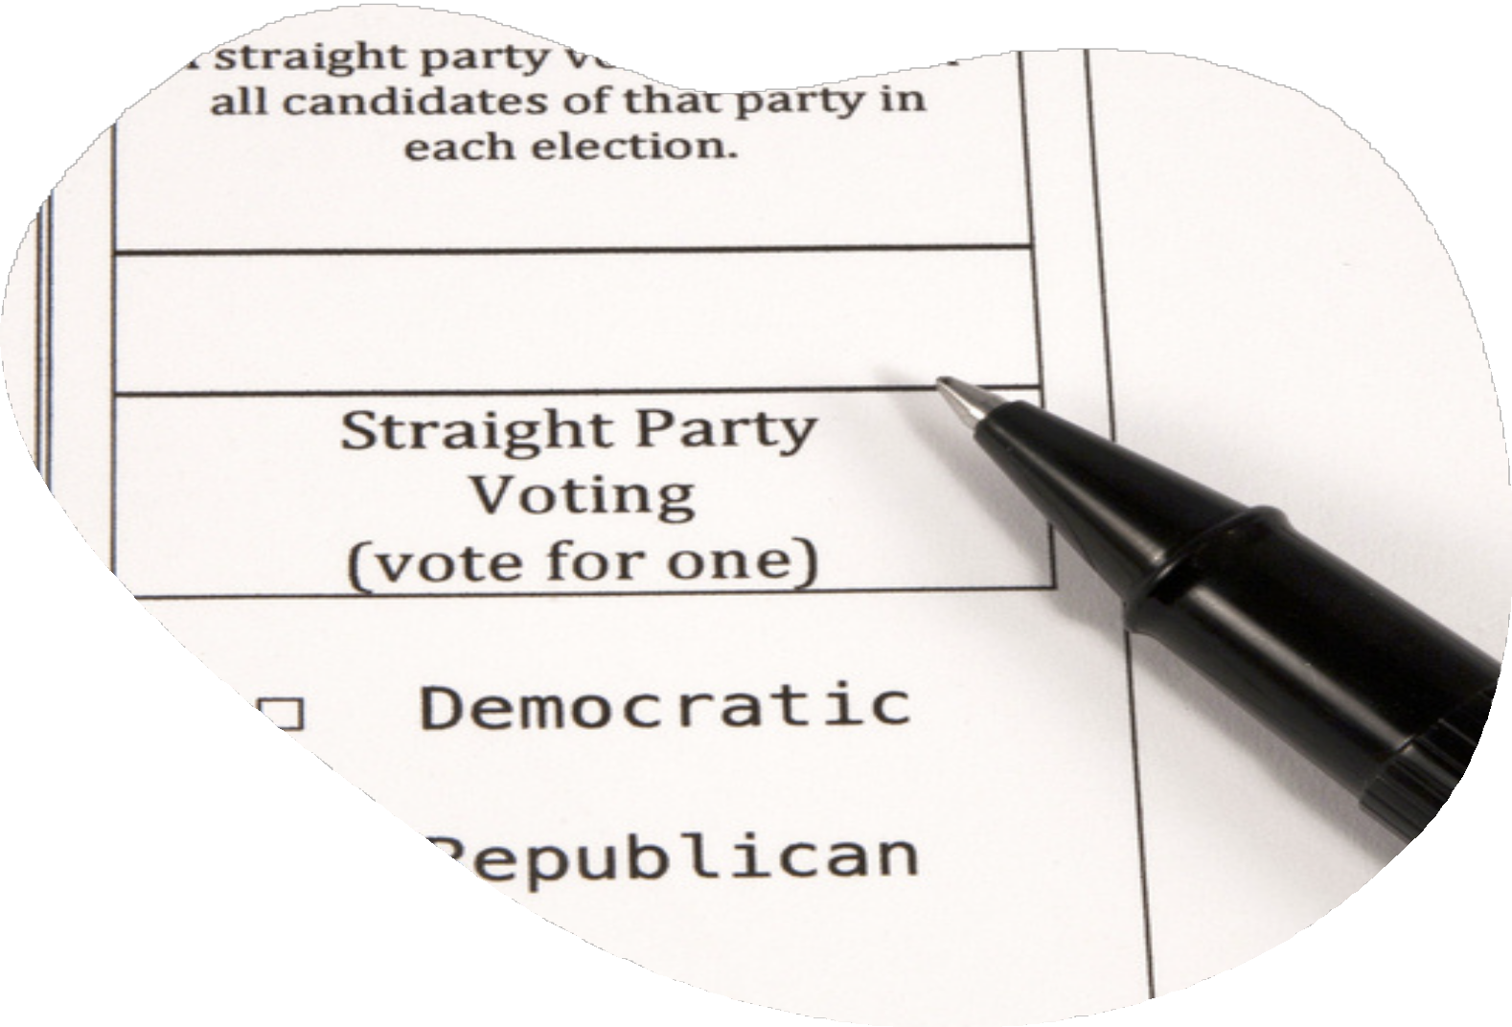
Voting Procedure
When voting takes place in the meeting room, appointed tellers distribute, collect, and count the ballots. Tellers should be dependable and accurate.
Voters are instructed, either verbally or by written instruction on the ballot, on how to mark the ballot and how to fold the ballot.
Plurality
Majority
Notes:
Let’s talk quickly about voting. We’ve all voted for officers right? Question – can you be on the ballot and be a teller? Why not? Your bylaws should determine the voting process, such as elections shall be by ballot. Can someone tell me why this is the recommended way for elections? It is secret, it allows the presiding officer and the parliamentarian to participate in the process. There should also be a clause in the bylaws that states if there is no more than one nominee for an office, the chair shall declare the candidate elected. If this clause is not there, you must ballot that one person and vote. What is a majority? More than half. What is a plurality? The one with the highest votes – this can only happen if there are more than three candidates AND your bylaws allows it. Which one serves the organization best? Let’s do an example – there are three candidates and A receives 45 votes, B receives 40 votes and C receives 25 votes. If a majority is required, who won? (Noone – majority is 56) If plurality is required then A won BUT it is not the pleasure of the body.

Slide 33
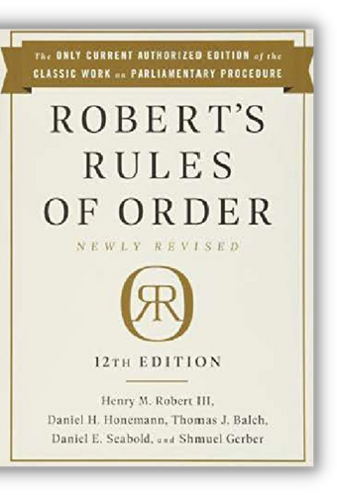
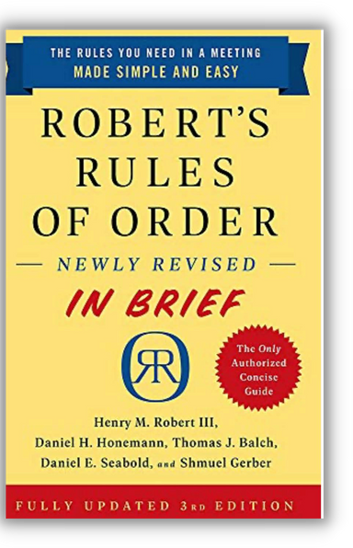
Resources
National Association of Parliamentarians https://www.parliamentarians.org
Roberts Rules of Order
Roberts Rules of Order-In Brief
Notes:
I appreciate you giving me your time and I hope that I have helped you understand a little more about parliamentary procedure. I encourage you to visit a unit meeting, and you can find one on the NAP website under the calendar. Most of us meet virtually. Let’s talk about the clip we saw at the beginning. How do you think this could have been handled better?

Slide 34


Contact Us
kellylucas97@yahoo.com
president@aacunap.org
Notes:
Here is my information again and if you’d like to visit my unit meeting, feel free to contact me.

Slide 35
THANK YOU

