Slide 1

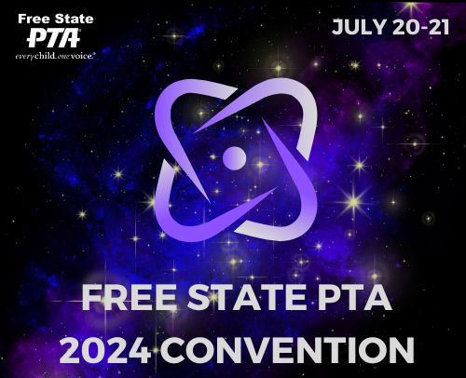
Mastering the Force of Event Planning: A PTA Workshop for Galactic Success
Creating Memorable and Engaging Community Events
Rae Sinanan-Hill
Director at Large, Free State PTA
Rsinanan-hill@fspta.org

Slide 2
Introduction
Purpose: Why effective event planning is crucial for PTA success
Goals: Enhance community engagement, improve participation, and create memorable experiences for our students, families, teachers and staff

Slide 3

Understanding Your Audience
Identify the target audience (students, grade level, parents, teachers)
1
Gather feedback and understand their needs and interests
2
Tailor events to address these needs

Slide 4
Setting Clear Objectives
Define the purpose of the event
Set measurable goals (attendance numbers, fundraising targets)
Ensure objectives align with PTA's mission and values

Slide 5
Budgeting and Resources
Develop a timeline
01
Include milestones and deadlines (planning, promotion, execution)
02
Assign tasks to team members
03

Slide 6
Event Planning Timeline
Create a detailed budget
1
Identify funding sources (sponsorships, grants, ticket sales)
2
Allocate resources effectively (volunteers, materials, venues)
3

Slide 7

Promotion and Marketing
Utilize
Utilize multiple channels (social media, newsletters, flyers)
Engage
Engage local media and community partners
Create
Create engaging content to attract attendees

Slide 8

Volunteer Management
Recruit and train volunteers
Clearly define roles and responsibilities
Recognize and appreciate volunteer contributions

Slide 9
Day of Event Coordination
Develop an event schedule
01
Ensure all logistics are in place (venue setup, AV equipment)
02
Have a contingency plan for potential issues
03

Slide 10
Post-Event Evaluation
Collect feedback from attendees and volunteers
Analyze what worked and what didn’t
Use insights to improve future events

Slide 11
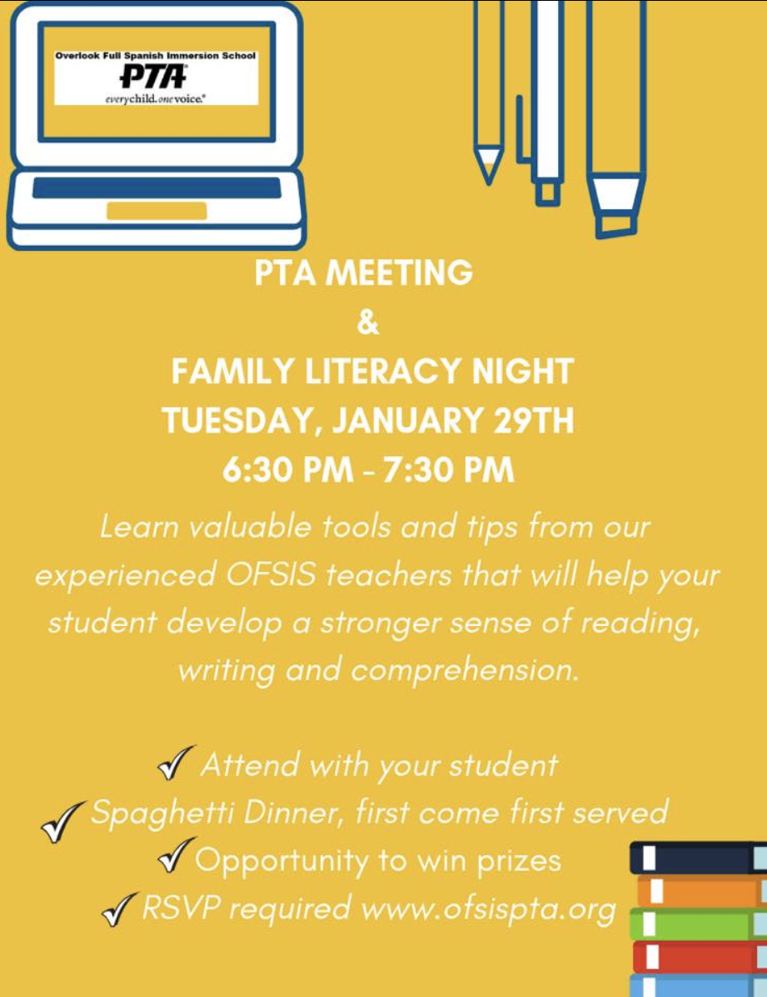
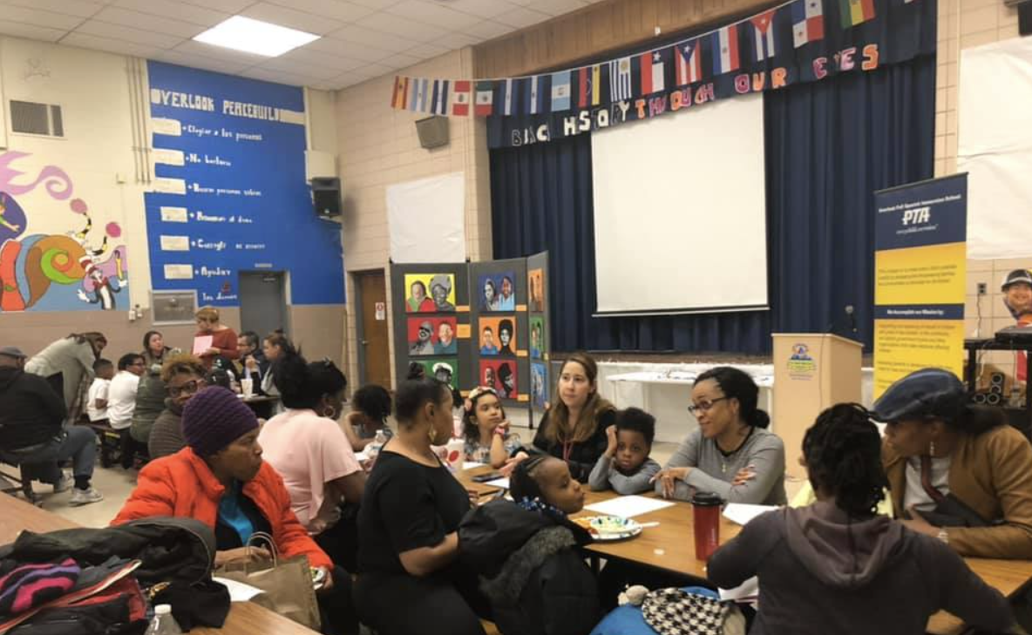
Case Study:
Family Literacy Night

Slide 12
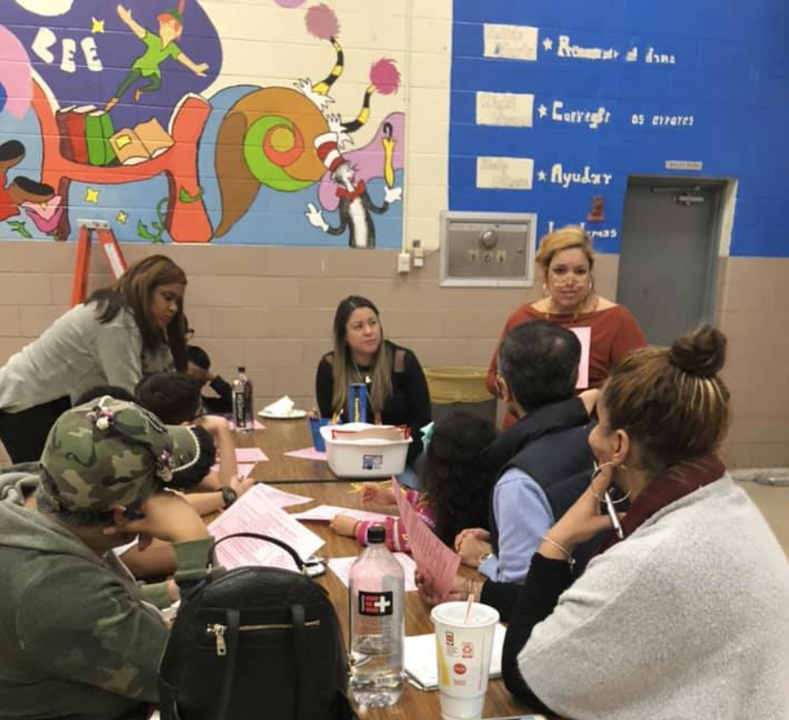
Event Overview + Goals
Family Literacy Night is an engaging and educational event organized by the PTA to promote the importance of reading and literacy within the community. It aims to bring families together in a fun, interactive environment where children and their parents can explore the joys of reading and storytelling.
Promote Literacy: Encourage reading and literacy among students and their families.
Community Engagement: Foster a sense of community and collaboration among parents, teachers, and students.
Educational Support: Provide resources and strategies to help parents support their children’s reading development at home.

Slide 13
Planning & Coordination
Concept Development:
- Brainstorm ideas for the event.
- Define the event’s purpose and goals.
Forming the Planning Team:
- Identify and recruit key team members and volunteers.
- Assign roles and responsibilities (e.g., event coordinator, teachers, committee members).
Meeting and Communication:
- Schedule regular planning meetings.
- Use collaborative tools (e.g., shared documents) for communication and task tracking.
Budgeting and Funding
- Estimate all potential costs (venue, equipment, marketing, food, etc.).
- Determine available funds and identify funding gaps.

Slide 14
Planning & Coordination
Sponsorship and Grants:
- Approach potential sponsors and donors.
- Apply for grants if available.
Logistics and Operations
Venue Booking:
- Research and book a suitable space
- Ensure the space meets all requirements (capacity, accessibility, facilities).
Vendor Coordination:
- Identify and negotiate with vendors (caterers, equipment rental, decorators).
- Confirm contracts and agreements.

Slide 15
Planning & Coordination
Program and Schedule Planning
Event Schedule:
- Develop a detailed schedule of activities for the event.
- Include setup, event execution, and teardown times.
Speaker Coordination:
- Contact and confirm speakers or performers.
- Arrange for any special requirements they may have (AV equipment, accommodations).
Promotion and Marketing
Marketing Strategy:
- Develop a comprehensive marketing plan.
- Prepare promotional materials (flyers, social media posts, press releases).

Slide 16
Planning & Coordination
Publicity:
- Identify target audiences and the best channels to reach them.
- Create a timeline for promotional activities leading up to the event.
Volunteer Management
Recruitment:
- Identify volunteer needs and roles.
- Recruit volunteers through various channels (PTA meetings, school newsletters, social media).
Training:
- Provide training sessions for volunteers.
- Ensure all volunteers are clear on their roles and responsibilities.

Slide 17
Planning & Coordination
Logistical Preparation
Supplies and Equipment:
- Order or gather necessary supplies and equipment.
- Ensure everything is ready and in working order before the event.
Contingency Planning:
- Develop backup plans for potential issues (bad weather, technical problems).
- Ensure there are solutions for common challenges that may arise.
Internal Communication
Team Coordination:
- Maintain clear and regular communication within the planning team.
- Use project management tools to keep everyone on track.

Slide 18
Planning & Coordination
Progress Tracking:
- Regularly review progress against the plan.
- Adjust tasks and timelines as necessary.
Final Preparations
Run-throughs and Rehearsals: (if needed)
- Conduct run-throughs of the event with the planning team and key participants.
- Address any issues that arise during rehearsals.
Final Checklists:
- Review all checklists to ensure nothing has been overlooked.
- Confirm all arrangements and logistics.

Slide 19
Planning & Coordination
By meticulously managing these behind-the-scenes tasks, the planning team ensures a well-organized and successful event that appears seamless to the public.

Slide 20
Event Components
Welcome and Introduction:
  Brief welcome by the PTA president.
  Outline the evening’s activities and objectives.
Storytelling Sessions:
  Teachers and parent volunteers read aloud from popular children’s books.
  Interactive storytelling with props and costumes to make the stories come alive.
Reading Station | Breakout Sessions:
  Multiple stations set up with different themes (e.g., escape room, fantasy, adventure, science fiction).
  Each station or room features a selection of books and related activities or crafts.
Guest Speakers:
  Prince George’s County Librarian present tips and strategies for parents to support reading at home.
  Library Card

Slide 21
Event Components
Book Swap:
  Encourage families bring gently used books from home to exchange with others.
  School distributed books to families
  Promotes sharing and gives everyone a chance to discover new books.
Reading Challenges and Prizes:
  Set up reading challenges for different age groups with small incentives for participation.
  Prizes for reading milestones or participation in various activities throughout the night.
Interactive Activities:
  Word games, puzzles, and other literacy-based activities that families can enjoy together.
  Stations with educational apps and digital tools that support reading and literacy.

Slide 22
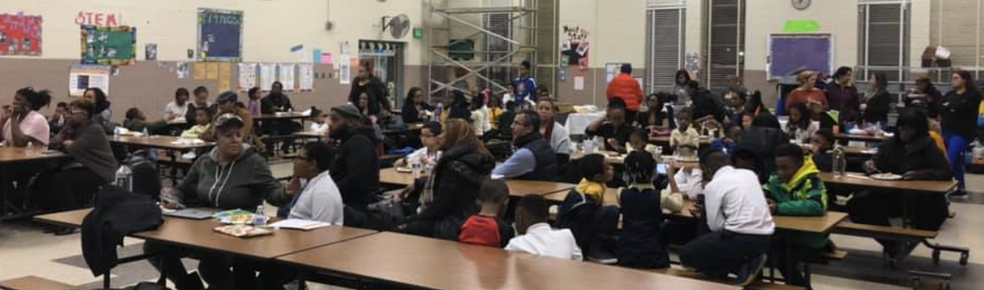
Event Components
Refreshments and Socializing:
  Light snacks and refreshments provided to encourage families to mingle and discuss their favorite books and stories.
  Comfortable reading corners where families can sit and read together.
Resource Tables:
  Information on local libraries, reading programs, and other literacy resources available in the community.
  Take-home materials for parents with reading tips and book recommendations.

Slide 23
Promotion and Marketing
Flyers: Posted on Class Dojo, emailed to PTA members, GroupMe Messages and Weekly PTA Newsletter
Social Media: Regular updates and event details shared on the PTA’s social media platforms.

Slide 24
Post Event Survey Categories
General Feedback: Overall, how satisfied were you with the event?
Event Specifics: How would you rate the following aspects: Event Organization, Quality of activities/sessions, communication and information provided
Content and Activities: What did you find most valuable about the event.
Logistic and Organization
Future Improvements
These categories can help gather valuable feedback to improve future events and better understand the needs and preferences of your attendees.

Slide 25
Recap
Summary of Key Points:
Know your audience
Set clear objectives
Efficient budget and resource management
Effective promotion and marketing
Recruit and appreciate volunteers
Detailed event coordination
Post-event evaluation
Importance of Community Engagement:
Strengthens parent-teacher-student relationships
Builds a supportive and collaborative community
Notes:
Recap key points of effective event planning
Emphasize the importance of community involvement
Encourage continued learning and collaboration

Slide 26

Questions and Discussion

Slide 27



Contact Us
rsinanan-hill@fspta.org
fspta.org

Slide 28
THANK YOU

Slide 29
Additional Resources
Rae to:
Provide Attendees with samples
Event planning checklist
Sample budget template
List of useful tools and resources

