Slide 1


Harnessing the force
Essential skills for PTA Secretaries
Ashley cotton
Notes:
Good day and welcome everyone! This workshop is called Harnessing the Force: Essential Skills for PTA Secretaries. I’m Ashley Cotton, Free State PTA Secretary, and I’m happy to be here with you all. In this presentation, I’d like to share some essentials, some tips and some best practices to prepare you to be a really effective Secretary for your Parent Teacher Association.

Slide 2
PTA Mission
To make every child’s potential a reality by engaging and empowering families and communities to advocate for all children.
Notes:
It’s a good idea to start every meeting or engagement by reciting the PTA Mission. You should know it by heart. It is the backbone of all the work that we do, sets the tone for the meeting, and is important to keep at the forefront of our minds for everything that we do. If you feel that the mood is off at the start of a meeting, notice how the energy in the room changes after repeating the mission.

Slide 3
A New Hope: The Role of the Secretary
Overview of the Secretary’s Role in a PTA
Importance of Effective Record-Keeping
Ensuring Smooth Operation of Meetings
Expert Tips and Best Practices
Your role is pivotal in ensuring clarity and continuity.
Notes:
We know that the secretary is responsible for documenting the minutes and distributing them in a timely manner afterwards.
For instance, in Free State PTA, according to its bylaws –
The secretary shall:
1. serve as a member of the board of directors;
2. record and maintain the minutes of all meetings of the board of directors, executive
committee, and the general membership;
3. send, or cause to be sent, notice of meetings of the members and of the board of
directors; and
4. perform such other duties as may be provided for by these bylaws, prescribed by the
parliamentary authority, or directed by the board of directors or the association.
It is in the execution of these duties, that we realize that this position is so much more than minutes. Your role is pivotal in ensuring clarity and continuity. To do it well, it requires that you recognize that your role is critical, embrace that power, and OWN IT. Your minutes and the effectiveness of your organization depends on it.

Slide 4

The Force Awakens: Core Duties
Preparing Agendas and Meeting Notices
Taking and Distributing Meeting Minutes
Managing Correspondence
Maintaining Records and Files
Notes:
PTA is bigger than the sum of its parts, but what is our piece of the pie? We all need to show up in order to be successful. As a PTA Secretary, we are responsible for several things, and I’m going to start off early dropping some gems that will help ensure an excellent head start.
Preparing Agendas and Meeting Notices
Meet with President to design meeting agenda.
Send out agenda drafts a week in advance for feedback.
Taking and Distributing Meeting Minutes
Record minutes during the meeting and circulate a draft within a reasonable time.
Use a template that follows the agenda to streamline documentation and makes information easy to find.
Managing Correspondence
Keep a log of all incoming and completed communication requests.
Maintaining Records and Files
Develop a standardized filing system for easy access and retrieval for all colleagues.

Slide 5
The Rise of Skywalker: Preparation
Meetings
Communications
Collaborate with the president on proposed agendas.
Ensure all materials are ready for distribution.
Confirm meeting details.
Prepare a script and Roll Call.
Use templates for consistency.
Craft clear messages and use plain language.
Schedule regular updates.
Know your audience.
Be accessible.
Notes:
Collaborate with the President on Agendas
Set a recurring meeting to discuss agenda items.
Determine timeboxes for each topic.
Ensure all materials are ready for distribution
Check that all reports and documents are in the correct format.
Amend naming conventions, grammar and filing.
Confirm meeting details
Send reminders to members with all necessary details.
Fill in known details for minutes in advance.
Prepare a script and Roll Call
Capture attendance and ensure quorum is established.
I’m going to share a bit about communications in general, as well, because while it goes for meetings, but it also goes for everything:
Use templates for consistency
Create templates for agendas, minutes, emails, and newsletters.
Get creative!
Consider appropriate variations and include options.
Craft clear messages
Use bullet points and highlight key information.
Ensure subject lines are descriptive and to the point.
Schedule regular updates
Decide on a timetable for sending out communications.
Use digital tools to automate and schedule these communications.
Know your audience.
Build relationships with your community.
Being an effective communicator requires connection.
Be accessible.
Consider Section 508 in all publications.
Endeavor to reach as many people as possible in your target audience.

Slide 6
Robert’s Rules of Order Q&A
How can I get an item on the agenda for a meeting?
For a proposed agenda to become the official agenda for a meeting, it must be adopted by the assembly at the outset of the meeting.
At the time that an agenda is presented for adoption, it is in order for any member to move to amend the proposed agenda by adding any item that the member desires to add, or by proposing any other change.
It is wrong to assume, as many do, that the president “sets the agenda.” It is common for the president to prepare a proposed agenda, but that becomes binding only if it is adopted by the full assembly, perhaps after amendments as just described. [RONR (12th ed.) 41:62; see also pp. 16–17 of RONR In Brief.]
Notes:
https://robertsrules.com/frequently-asked-questions/
That is to say, that a well-planned agenda is very likely to be adopted quickly and with minimal amendments.

Slide 7
Attack of the Clones: Agenda vs. Meeting Minutes
Agenda aka order of business
Meeting Minutes
Every meeting has a purpose.
After the meeting has been called to order, note the time and call the roll.
Basic headings covering business:
  Reading/Approval of Minutes
  Consent Agenda or Reading of Officers, Board, and Committee Reports
  Special Order
  Unfinished Business and General Orders
  New Business
Meeting minutes should match the agenda item headers.
Special meetings must specify why.
First paragraph should contain:
  The kind of meeting: regular, special, executive or board, etc.
  The name of your PTA
  Date, Time, and Place (Virtual or Physical Location)
  Roll Call indicating Present, Absent, any Vacancies
  Approval of Previous Meeting Minutes
Notes:
When written reports are received from boards or committees (which they should be submitted at least a week in advance of Executive or Board meetings, so members have a chance to read and digest them in advance), the secretary may record the date they were received, any further action was taken on them and preserves them in the filing system.
“Any member has a right to examine these reports and the record book(s)… including the minutes of an executive session, at a reasonable time and place, but this privilege must not be abused to the annoyance of the secretary.” RONR 47:36

Slide 8
Return of the Jedi: Meeting Minutes Continued…
The body of the minutes should contain:
  Separate paragraphs/segments for each subject matter,
  All motions, specifying
    The wording in which each motion was adopted or disposed, and the name of the maker;
    The facts of any debate or amendments made before disposition (mentioned parenthetically); and
    The disposition of the motion, including vote counts for Yays (in favor) and Nays (opposed), or “unamimous consent”;
  Complete substance of oral committee reports; and
  All points of order and appeals, whether sustained or lost, with reasons given by the chair for ruling.
The final paragraph should contain:
  The time of adjournment.

Slide 9

The Empire Strikes Back: During the Meeting
Recording Accurate and Comprehensive Minutes
  Focus on capturing motions, seconds, and voting outcomes precisely.
Noting Attendance and Voting Results
  Track attendance carefully and note who is absent.
  Use a prepared script to easily identify expected attendees and guests.
Assisting the President with Procedural Matters
  Know your local unit’s PTA bylaws and standing rules.
  Have a copy of Robert’s Rules of Order on hand for reference.

Slide 10
Robert’s Rules of Order Q&A
Isn't it necessary to summarize matters discussed at a meeting in the minutes of that meeting in order for the minutes to be complete?
Not only is it not necessary to summarize matters discussed at a meeting in the minutes of that meeting, it is improper to do so. Minutes are a record of what was done at a meeting, not a record of what was said. [RONR (12th ed.) 48:2; see also pp. 148–49 of RONR In Brief.]
Notes:
https://robertsrules.com/frequently-asked-questions/

Slide 11
Return of the Jedi: Post-Meeting Duties
Finalizing and Distributing Minutes
Updating Records/Filing Documentation
Include any corrections or amendments from members.
Use track changes and comments until documents finalized.
Send out minutes in a timely manner.
Encourage collaborative review methods, like Teams or Google docs.
Organize minutes chronologically and by topic.
Determine a set of metadata tags for search optimization.
Archive old documentation.
Carefully identify duplicate records and unnecessary drafts for removal.

Slide 12
Robert’s Rules of Order Q&A
If minutes of a previous meeting are corrected, are the corrections entered in the minutes of the meeting at which the corrections were made?
If corrections to minutes are made at the time when those minutes are originally submitted for approval, such corrections are made in the text of the minutes being approved. The minutes of the meeting at which the corrections are made should merely indicate that the minutes were approved “as corrected,” without specifying what the correction was.
If it becomes necessary to correct minutes after they have initially been approved, such correction can be made by means of the motion to Amend Something Previously Adopted. Since the motion to Amend Something Previously Adopted is a main motion, the exact wording of that motion, whether adopted or rejected, should be entered in the minutes of the meeting at which it was considered.
[RONR (12th ed.) 48:4(5), 48:15; see also p. 153 of RONR In Brief.]
Notes:
https://robertsrules.com/frequently-asked-questions/
If a correction to previously approved minutes is adopted, the secretary does not actually alter the content of the original minutes, but may make a marginal notation indicating the corrected text or referring to the minutes of the meeting at which the correction was adopted.

Slide 13
The Phantom Menace: Minute-Taking Tips
Use clear and concise language. Avoid jargon and keep sentences short.
Use links to quickly direct recipients to references.
Focus on decisions made and actions taken. Highlight key resolutions, action items and next steps.
Avoid personal opinions or detailed discussions. Stick to the facts and objective commentary.
Votes captured during an Executive Session should be documented, but only to the extent to carry out any resulting action.

Slide 14

The Last Jedi: Best Practices
Consistency in Document Formatting
  Use templates for agendas and minutes to ensure uniformity.
Timeliness in Distributing Information
  Aim to circulate documents within a predetermined timeframe that ensure that everyone is aware and accountable for their responsibilities.
Confidentiality and Sensitivity Handling
  Be discreet with sensitive information and secure documents.
Create a Transition Guide
  Document key processes, contacts and tools used.
Engage in Continuous Learning
  Stay updated on best practices and changes to governance policies.

Slide 15

The Force is Strong With This One: Robert’s Rules
Understanding Key Procedures and Terminology
  Familiarize yourself with common terms like “quorum” and “motion”.
Ensuring Fair and Orderly Meetings
  Encourage balanced participations and orderly discussions.
Facilitate Constructive and Inclusive Discussions
  Promote a respectful environment where all voices are heard.

Slide 16

The Rise of Skywalker: Staying Organized
Choose Your Systems, Maintain Your Choices
  Know your platforms and preferences.
  Choose protocols you can live with.
  Regularly update contact lists and records systems.
Leverage Digital Tools
  Keep a calendar of events and deadlines on a digital calendar with reminders for key dates.
  Manage digital directories and subscriptions.
  Implement cloud storage solutions for centralized access and backup.
  Take trainings and stay up-to-date with the functionalities of your technology.

Slide 17

Secrets of the Jedi: Expert Tips
Use a Template for Minutes
  Pre-fill recurring and known sections to save time.
Create an Action Item Tracker
  Use a shared document or project management software to track progress on tasks.
Set Up Automated Reminders
  Use tools like email and social media schedulers to send out correspondences and remind members of deadlines.
Build Relationships with Key Members
  Regularly touch base with the president and committee chairs for smooth collaboration and understanding.

Slide 18

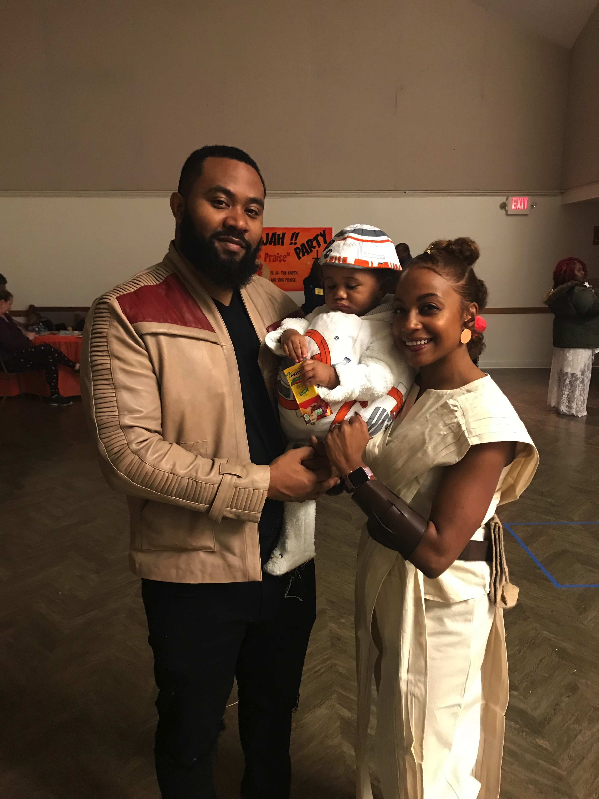




Contact Us
Click Image
to Email Me!
www.fspta.org

Slide 19
THANK YOU

